Slide 1
CORONARY HEART DISEASE
By: Koushik Jandhyala
Notes:
Hello everyone, my name is Koushik Jandhyala and my EDA Final Project is on Coronary heart disease

Slide 2
Using Machine Learning to Predict Heart Disease in Patients
UCI Coronary Heart Disease Library
https://archive.ics.uci.edu/ml/datasets/Heart+Disease
Themes
Machine Learning / Artificial Intelligence
HealthCare
Objective
Correlate symptoms with disease
Find which features influence the outcome the most
Notes:
This Project makes use of the data repository on Heart Disease in Patients, which can be found on the UCI(University of California, Irvine) Machine Learning Repository(https://archive.ics.uci.edu/ml/datasets/Heart+Disease). The theme of this project is based on the implementation of Machine Learning and Artificial Intelligence in the HealthCare Field. The project aims to retrieve the data from UCI and apply a regression model and analysis on the data to determine if a patient presenting symptoms has the possibility to have Heart Disease

Slide 3
ABOUT THE DISEASE
Notes:
Let’s start off by talk about what the disease is

Slide 4
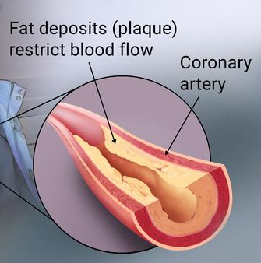
What is Coronary Heart Disease
CAD / Atherosclerotic Heart Disease
Most common heart disease
Build up of fat deposits in the coronary arteries
Restricts blood flow
Caused by high cholesterol
Right Coronary Artery
Left
Coronary Artery
Notes:
Also known as CAD and Atherosclerotic(Athe-ro-skle-rotic) Heart Disease, Coronary Heart Disease is the most common form of heart disease in the world, with more than 3 million cases per year in the US alone. It is caused by a build of fat deposits, more commonly known as plaque within the coronary arteries. This presents numerous challenges because the excess plaque results in restricted blood flow. Restricted blood flow translates to less Oxygen rich blood traveling throughout the body. CAD is caused by high cholesterol levels and requires surgery as well as many lifestyle changes.

Slide 5

ABOUT THE MODEL

Slide 6
Steps to the Model
01
02
03
Preprocessing
Fit the Model
Analyze the results
Notes:
We have to preprocess the data to get rid of the values either don’t want or need

Slide 7
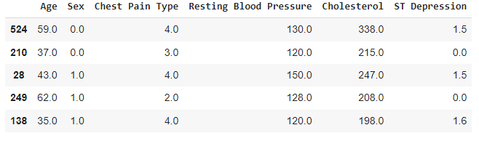
Preprocessing The Data
Data from UCI
5 different files
Cannot use some
Making column headers
Seperate the diagnosis
Dropping unnecessary columns
Fix NaN values
Notes:
The data from UCI ML Repository comes in 5 different files. To which the last 2 we cannot use as they are full of NaN Values. We start off by making the column headers into the 14 different specified Column values and then separating the diagnosis into its own column. We drop the unnecessary columns(mainly the binary values) And just patching up some of the nan values here and there to create a functional dataset

Slide 8
Attributes of the Dataset
Age -> Age in years
Sex -> Sex
1 = male
0 = female
Chest Pain Type -> Type of chest pain
1: typical angina
2: atypical angina
3: non-anginal pain
4: asymptomatic
Notes:
The data from UCI ML Repository comes in 5 different files. To which the last 2 we cannot use as they are full of NaN Values. We start off by making the column headers into the 14 different specified Column values and then separating the diagnosis into its own column. We drop the unnecessary columns(mainly the binary values) And just patching up some of the nan values here and there to create a functional dataset

Slide 9
Attributes of the Dataset
Resting Blood Pressure -> Resting blood pressure (in mm Hg on admission to the hospital)
Cholesterol -> Total cholesterol in mg/dl
ST Depression -> ST depression induced by exercise relative to rest
Diagnosis -> Diagnosis
0: Does not have
Greater than or equal to 1: Has disease
Notes:
The data from UCI ML Repository comes in 5 different files. To which the last 2 we cannot use as they are full of NaN Values. We start off by making the column headers into the 14 different specified Column values and then separating the diagnosis into its own column. We drop the unnecessary columns(mainly the binary values) And just patching up some of the nan values here and there to create a functional dataset

Slide 10

The Model
Lasso Regression from SciKit Learn
Feature selection
Overfitting Minimization
Used np.arange() to generate all possibilities for lambda
Made a function to optimize lambda
Mapped highest scores with lambda
.score to evaluate model
Notes:
For this project I used the LASSO Regression class from SciKit Learn for 2 main reasons, the first being Lasso’s ability for feature selection and the second being its ability to minimize overfitting. To find the best lambda value for Lasso, I made and 80-20 split of the data and I implemented numpy arange to find all the lambda values between 0 and 1 in increments of 0.01. I made a function to optimize lambda by looping through and appending the test scores and then selecting and mapping the highest test score to the highest lambda value. The best Lambda value that I got was 0 which corresponds to a test score of about 41.75%. To evaluate the model, I used the “dot score” function from the LASSO class to see how good my model was

Slide 11
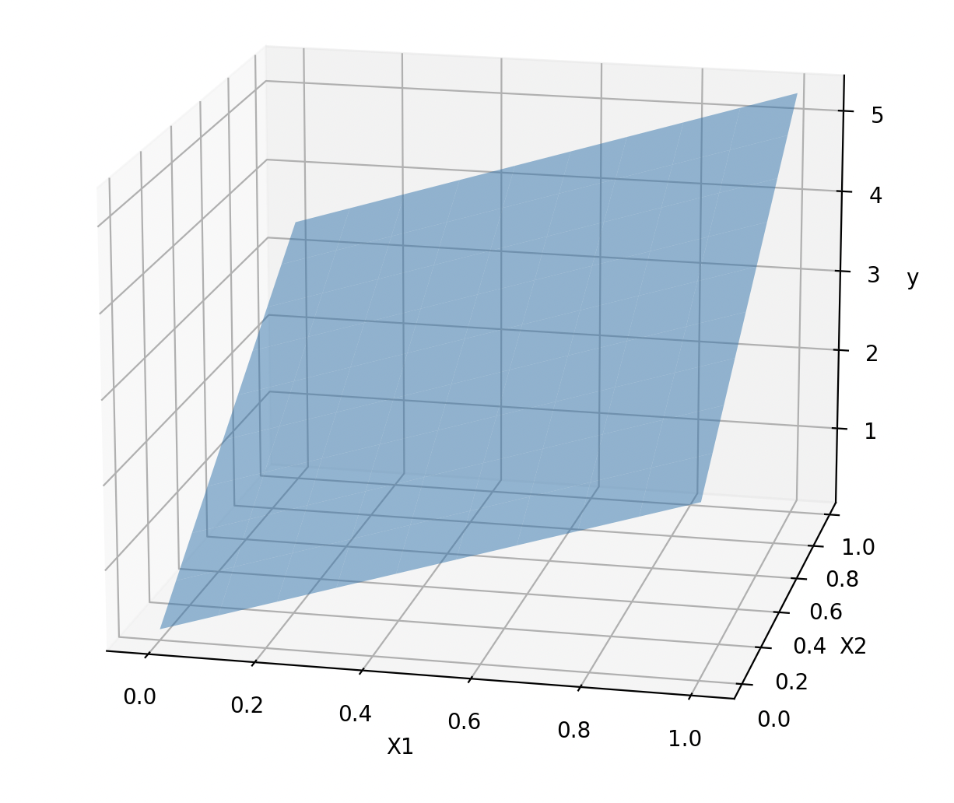
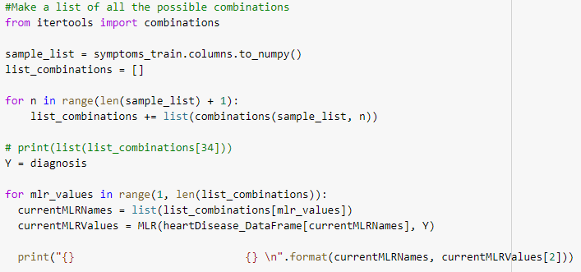
The Model
MLR Regression from SciKit Learn
Saw lambda was turning into linear regression
Visually found the largest train test score
itertools.combinations
Worse than lambda
R2_score from scikit to evaluate model
3D graph crashed my computer
Notes:
For this project I used the LASSO Regression class from SciKit Learn for 2 main reasons, the first being Lasso’s ability for feature selection and the second being its ability to minimize overfitting. To find the best lambda value for Lasso, I made and 80-20 split of the data and I implemented numpy arange to find all the lambda values between 0 and 1 in increments of 0.01. I made a function to optimize lambda by looping through and appending the test scores and then selecting and mapping the highest test score to the highest lambda value. The best Lambda value that I got was 0 which corresponds to a test score of about 41.75%. To evaluate the model, I used the “dot score” function from the LASSO class to see how good my model was

Slide 12
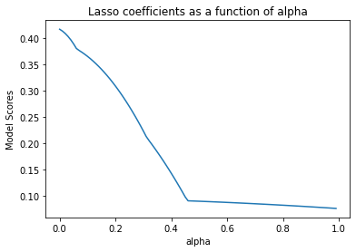
Interpreting the data
Low Lambda value works good
Notes:
2 things I learned from this data is that for this data the more features you have, the better the accuracy. Even though I had an accuracy of about 42%, this could be improved by using more complex models like logistic regression and implementing feature selection. The second thing I learned is that(ref 2nd graph) Males of all age groups are more likely to to get CAD than females.

Slide 13
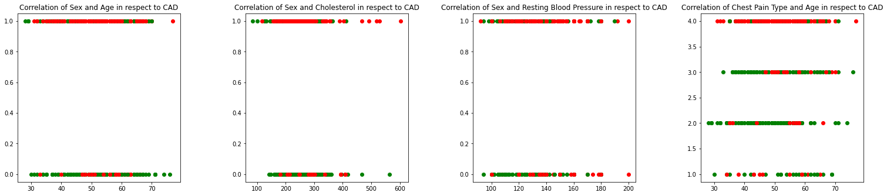
Interpreting the data
Some of the interesting correlations that I found
NIH: Overall, it appears that men's coping with stressful events may be less adaptive physiologically, behaviorally, and emotionally, contributing to their increased risk for CHD
Notes:
Studies suggest that the high levels of cortisol from long-term stress can increase blood cholesterol, triglycerides, blood sugar, and blood pressure. These are common risk factors for heart disease. This stress can also cause changes that promote the buildup of plaque deposits in the arteries.

Slide 14
Reflections and Moving Forward
This data set has a good future
Complex model
Using LASSO is bad
This dataset is a good partner
I could do differently
Better dataset / partner dataset

Slide 15
References
https://datagy.io/python-combinations-of-a-list/
https://colab.research.google.com/drive/1AkkG3KI_G-r1KTJ7TTdTYFowzvvPiUk7?usp=sharing

Slide 16
Thanks!!
Any questions?

